Slide 1
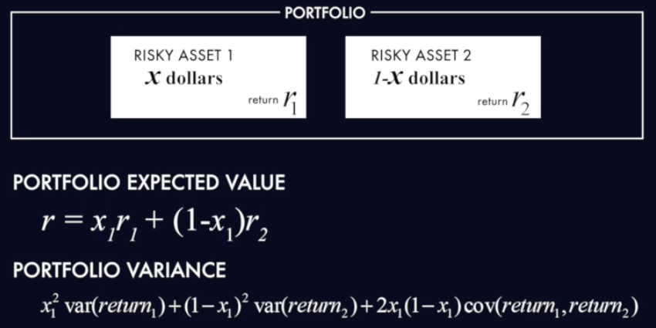
A Portfolio of 2 Risky Assets

Slide 2
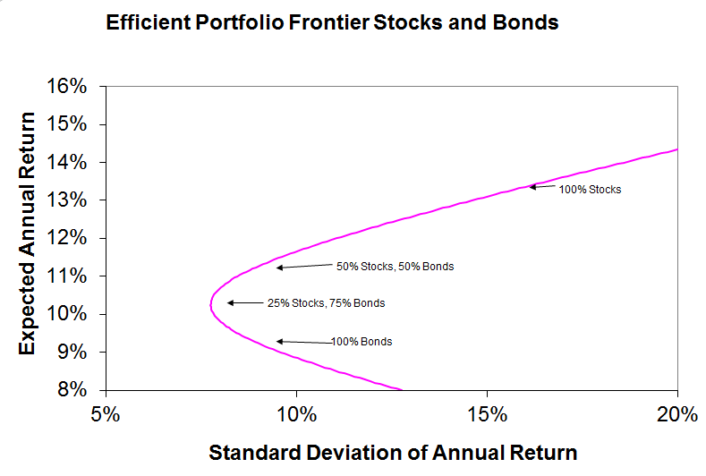

Slide 3
